Slide 1
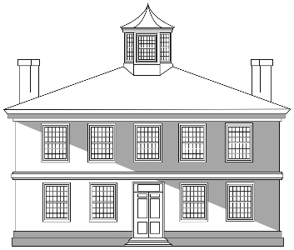
TELLING THE STORY OF NORTHERN COLONIAL ENSLAVEMENT --
Examples from The William Trent House
Notes:
Beginning about 10 years ago, the Trent House Association, which now manages the city-owned property, began exploring how to incorporate information about the lives of “invisible” inhabitants of the house into our interpretation.
Some of those “invisible” inhabitants include the Native peoples whose ancestral land was granted to colonists by the English king; Trent’s wife, as well as the other women who were residents in the house during the next 300 years; immigrants, usually women, who lived and worked in the house; and people from Africa enslaved by Trent as well as by other owners of the house. In this presentation we are focusing on the “invisible stories” of the enslaved individuals who we know were in William Trent’s household and how we’ve used primary sources to tell their stories.

Slide 2
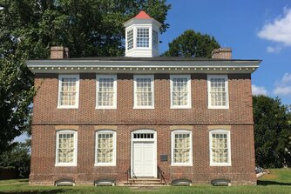
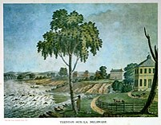
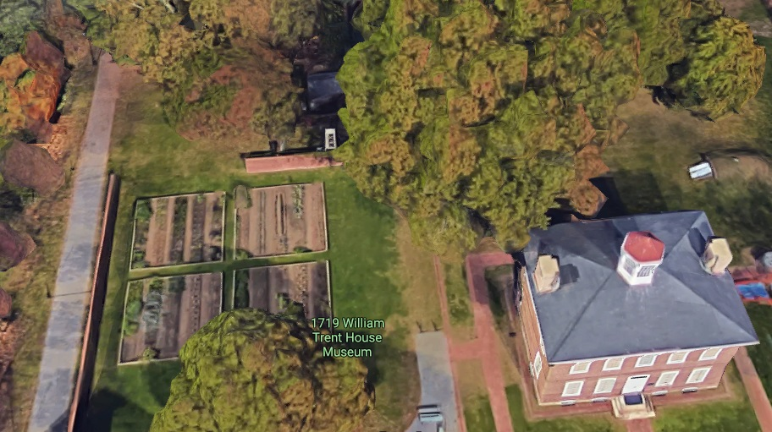
The William Trent House
Built in 1719 by a wealthy Philadelphia shipping merchant at the Falls of the Delaware on ancestral lands of the Lenni Lenape people.
Notes:
Land Acknowledgement:
The land on which the Trent House and the city of Trenton stands is part of the traditional territory of the Lenni-Lenape, called "Lenapehoking." During the colonial era and early federal period, many were removed west and north, but some also remain in continuing historical tribal communities of the region. We acknowledge the Lenni-Lenape as the original people of this land and their continuing relationship with their territory.​

Slide 3
Trent House Mission
To share the authentic history of the house, people, and property with our communities, connecting the past with today and tomorrow
Notes:
Mission:
To share the authentic history of the house, property, and people with our communities, connecting the past with today and tomorrow

Slide 4
How We Wanted to Use Primary Sources
To confirm that Trent participated in slavery as did many others in the northern colonies
Present the enslaved people as individuals
Illustrate both the hardship and indignity of slavery and the resilience and fortitude of enslaved people
Demonstrate how slavery was built on both institutional support and personal decisions
Notes:
Documentary evidence includes:
Trent’s trade ledgers from 1703 to 1708 in the archives of the Historical Society of Pennsylvania
Letters from Trent
Probate inventory conducted after Trent’s death
Runaway slave advertisement
Colonial laws related to slavery and enslaved people
Newspaper reports
It is powerful to use documents specifically tied to a particular location, especially one that is “near to home.” While our visitors are generally no longer surprised when they learn that there was slavery in NJ, they often don’t have a frame of reference for what the system of enslavement entailed here and their questions sometimes suggest that slavery was “better” here than in other colonies/states.
In this presentation I will illustrate how we use these primary sources to explore slavery in colonial New Jersey as it was lived in the Trent House in the early 1700s.

Slide 5
Domestic and International Slave Trade
Key points:
Trading in enslaved Africans was an accepted business practice and governed by legal regulations and standard practices.
Enslaved people were considered commodities as other items of trade.
The colonial elite were major participants in and beneficiaries from the slave trade.
The slave trade was also domestic – that is, involved transactions between colonists in the Americas.

Slide 6
Trent’s Involvement in the Slave Trade
We know from Trent’s trade ledgers that among the “goods” he bought and sold were enslaved people originally from Africa.
It is not known whether his ships transported kidnapped people from Africa itself.
Most of the transactions were with others in Philadelphia.
Purchases of enslaved people beyond Philadelphia most likely took place in the West Indies with which Trent traded extensively.
Notes:
During his career as a shipping merchant, Trent owned shares in about 40 ships. This allowed him to spread the risk associated with shipwreck, piracy, and other misadventures befalling shipping of the times.
The Archives of the Historical Society of PA contain original ledgers from Trent’s business from 1703 through 1708.. These ledgers illustrate the scope of his business – what he bought and sold, from whom, and where. Based on these records, we know that he had business relationships in other colonies in North America, the West Indies, and Central America and that he shipped products of the northern colonies like lumber and wheat and those of other colonies, especially the West Indies, like molasses and sugar. We also know from these ledgers that he transported indentured and enslaved people. In some cases he appeared to have been primarily involved in transport only, but in most he himself bought and sold people.

Slide 7
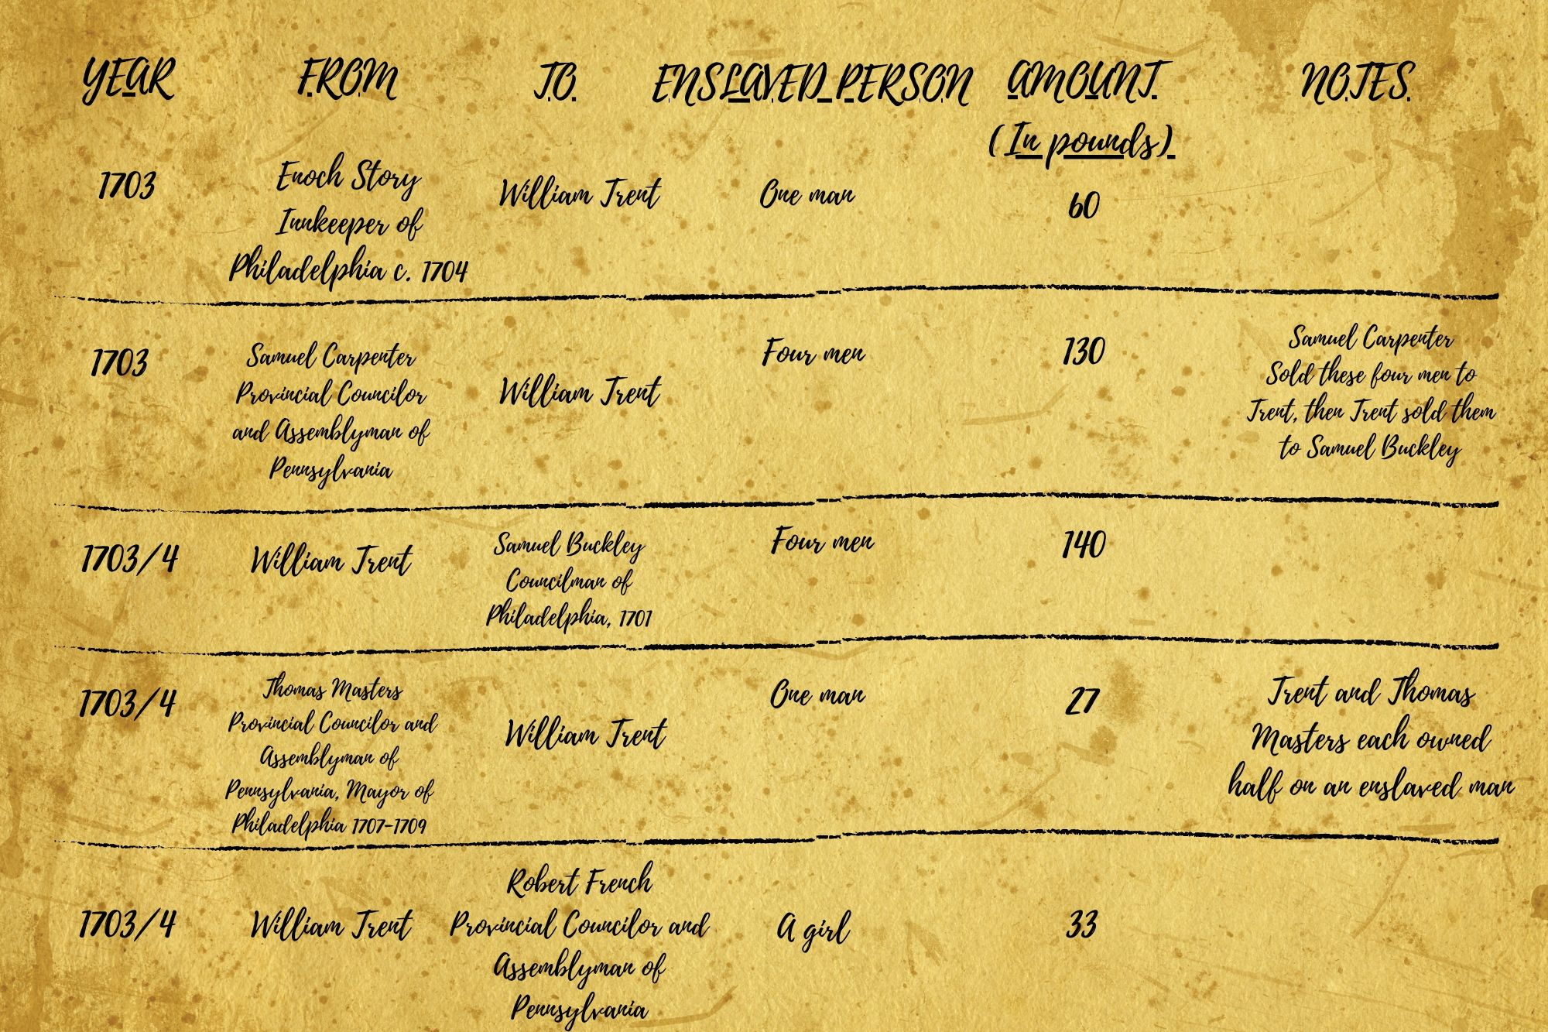
Trent’s Trade Ledgers
Notes:
Note that this is a chart summarizing the information on some of the 13 such transactions from ledgers of Trent’s transactions between 1703 through 1708. The actual ledgers themselves are hard to read and the accounting hard to follow.

Slide 8
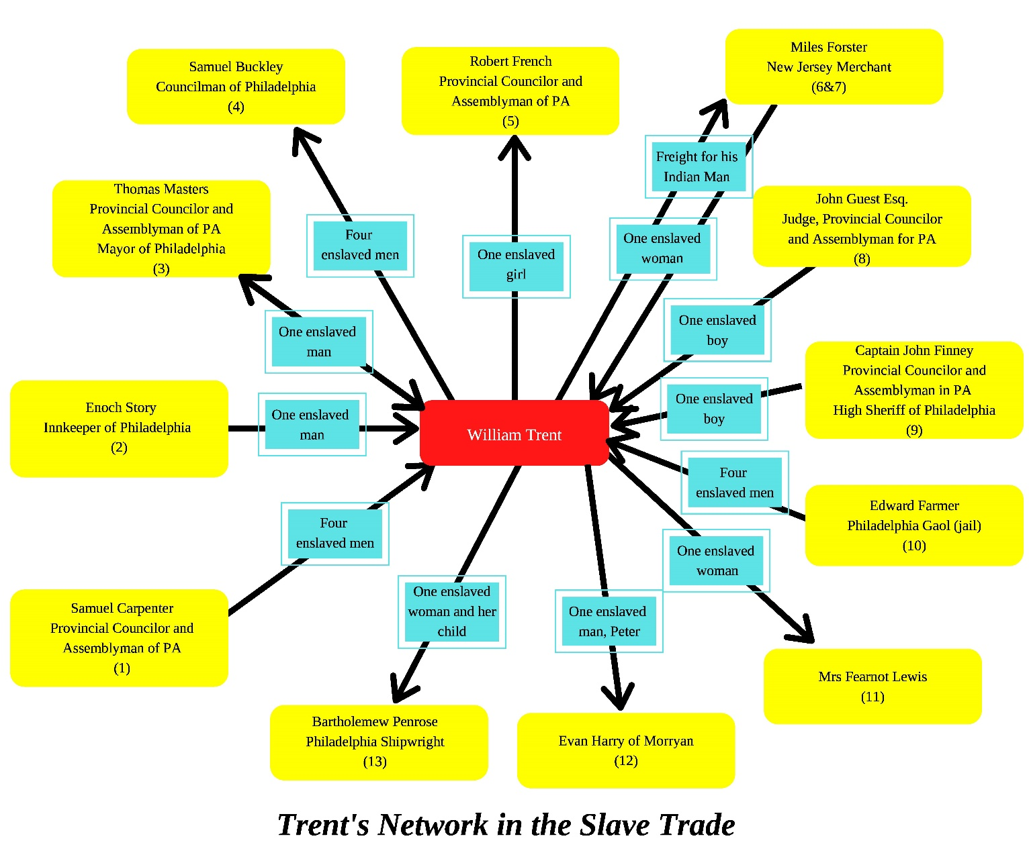
Buying and Selling Enslaved People
This poster shows the network of transactions between Trent and other prominent Philadelphians for enslaved people.
Blue boxes are enslaved people involved in transactions; yellow boxes are the Philadelphia politicians and merchants connected with Trent through transactions.
Notes:
From these ledgers, we were able to trace the connections through transactions involving enslaved people between Trent and many other wealthy and prominent men of Philadelphia of the time. This is one way to illustrate the prevalence of slavery as an economic institution generating wealth for the colonists and supported by both custom and law.
Details of each of these transactions are described in accompanying posters – two examples are given next.

Slide 9
John Guest was a judge and a Provincial Councillor and Assemblyman for Pennsylvania.
John Guest
William Trent
An enslaved boy for 40 pounds
Guest sold an enslaved boy to Trent in 1705/6.

Slide 10
Captain John Finney was a Provincial Councillor and Assemblyman of Philadelphia, as well as High Sheriff of Philadelphia.
William Trent
Captain John Finney
One enslaved boy for 40 pounds
Finney purchased an enslaved boy from Trent in 1705/6..
Notes:
It appears that this may have been the same boy and that Trent may have acted as middleman without taking a fee.
Note that we do not know the names of the enslaved people being bought and sold. This is a reminder of the status of these people as property – what was seen as relevant to record for each transaction is the gender and age range of the individual and the monetary value associated with the transaction.

Slide 11
Observations
  Enslavement was an individual decision, based on economic calculation, supported by law and custom, and justified by concept of “racial” hierarchy.
  Some colonists and Europeans raised concerns/objections to the kidnapping and enslavement of people from Africa, but financial considerations were often the primary consideration.

Slide 12
Slavery Wealth & Status
Key points:
Some slave-owning northern colonists had only a few enslaved and possibly indentured Africans and Europeans. Others like Trent held more.
Enslaved people provided free labor on farms, in mills, and in other wealth-producing activities.
Enslaved people also served to signify and demonstrate the status of their enslaver.
The monetary value assigned to enslaved people reflected their productivity, strength, and skills.

Slide 13
Trent as an Enslaver
When Trent died unexpectedly in 1724, he left no will. His young second wife sued the eldest son of Trent’s first marriage for her dower rights – one-third of Trent’s property.
In resolving the suit, a probate inventory was conducted, listing all of Trent’s possessions and assessing their monetary value in English pounds, shillings, and pence.
Notes:
When Trent died, his second wife was in her 30s with a young son. Her suit was to ensure that she received regular income from Trent’s rental properties and mills. She won her suit and while she lived to her 80s never remarried. Given that wives had no legal rights to own property, it is perhaps not surprising that she took this course.

Slide 14
Trent’s Probate Inventory
The inventory lists various household items and their assessed value in pounds, shillings and pence.
The inventory also lists 11 enslaved people: Yaff, Joan, Bob, Dick, Nanny, Tom, Julius, Bosin, Harry, Pedro, Cupid.
Notes:
We interpret the first six as working and living in the house and the five adult men as working and living elsewhere on Trent’s plantation – on his farms and orchards or in his mills. For example, from a letter from Trent to his eldest son James, we know that Harry was experienced in working in the bakehouse preparing bread for shipping to Philadelphia.
The other men are assumed to have worked on Trent’s plantation in other capacities, perhaps in the stable, farms, and mills.

Slide 15
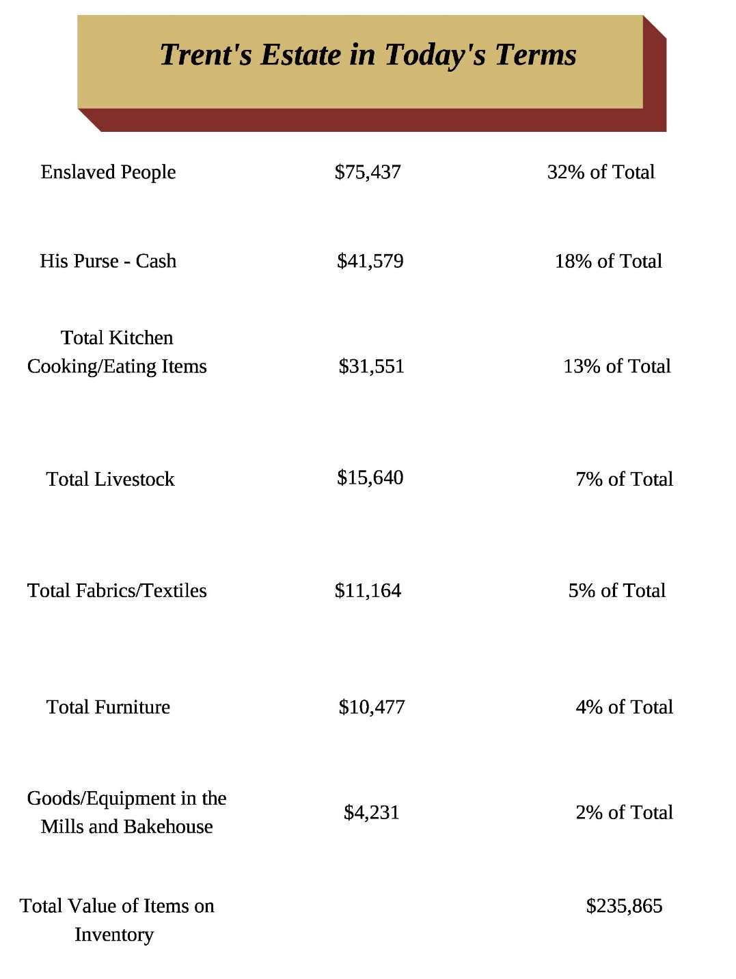
Enslaved People as Assets
This poster gives visitors a sense of Trent’s wealth and illustrates how the enslaved people were a major share of that wealth as measured by goods owned at the time of his death.
Notes:
We used an algorithm that converts English currency in the early 1700s to US currency of the early 21st century.
The eleven people listed on the inventory were assessed as about one-third of the value of his movable property – other than land and buildings.

Slide 16
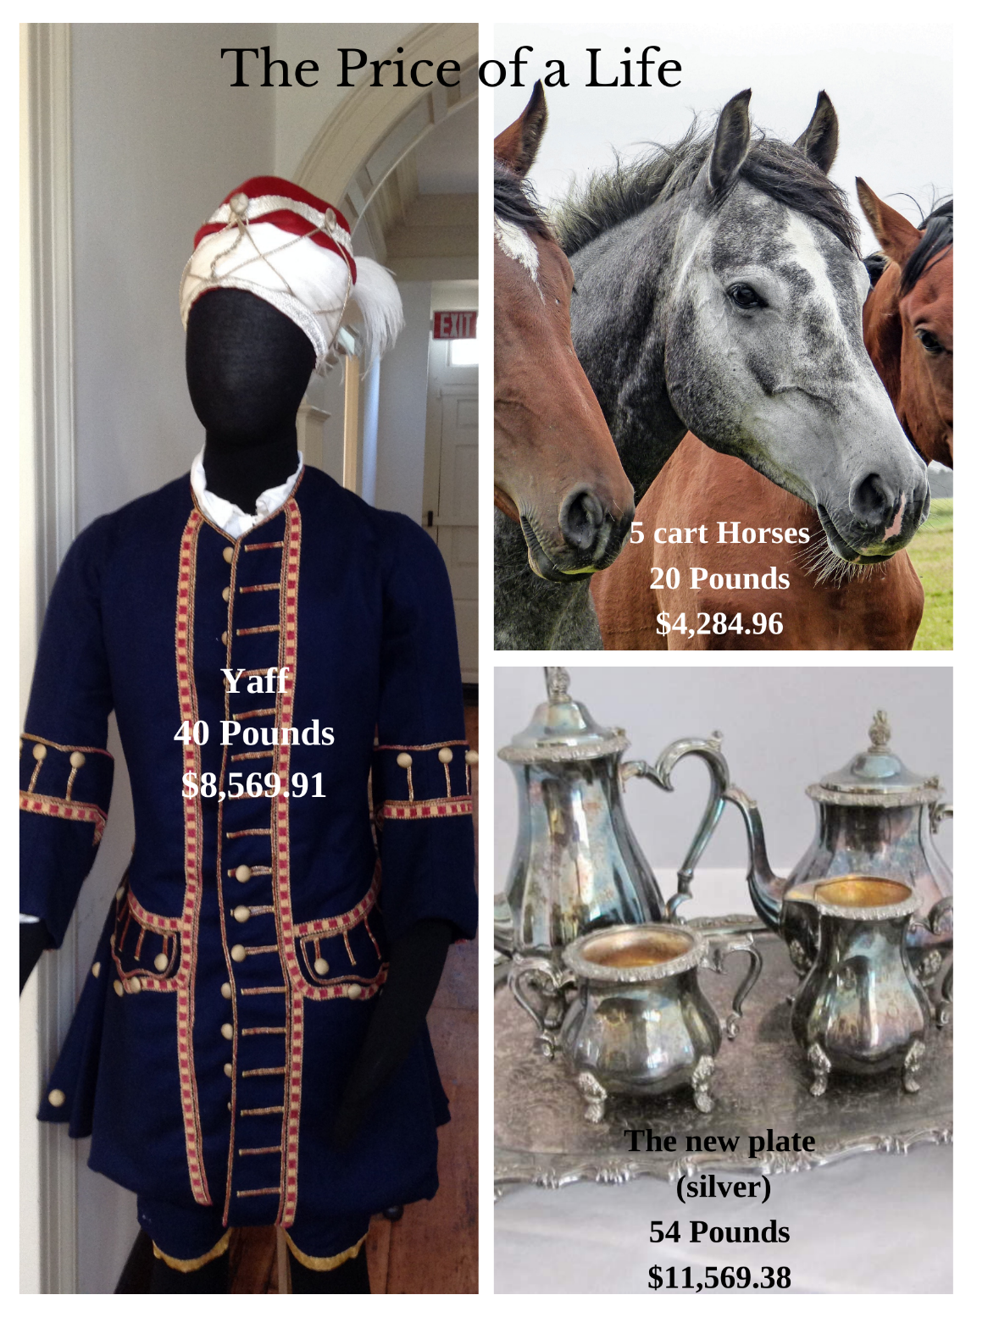
Price of a Life - Yaff
This poster illustrates that enslaved people were considered property in the same way as livestock and household goods.
It compares the assessed amount assigned to Yaff to that of specific other entries on the probate inventory.

Slide 17
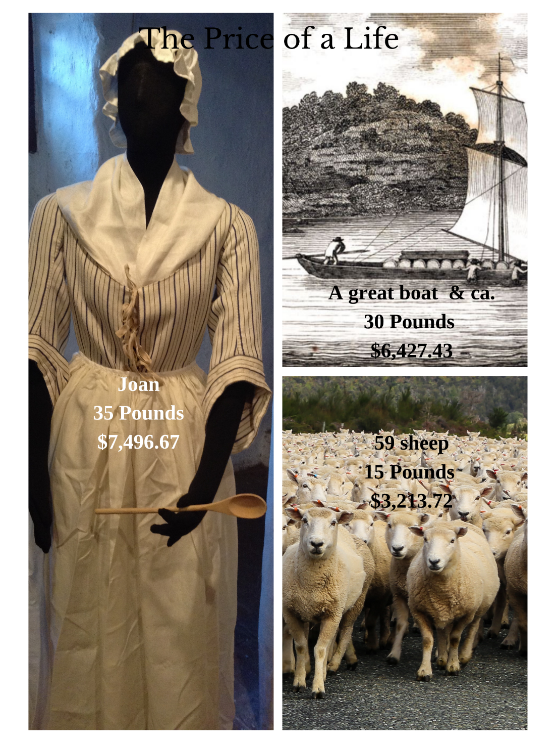
Price of a Life - Joan
Using cues from the inventory, we believe that Joan was particularly skilled. The amount assigned to Joan was more than two of the adult men and equal to that of another.
Nanny, the only other female listed, was also assigned an amount greater than that for two of the adult men. This again suggests that she had valuable skills and responsibilities.
Notes:
We are often asked whether the first six people listed on Trent’s inventory were related in some way, through birth or marriage, as they include two adults and four younger people. Unfortunately, we don’t know.
What we don’t know again illustrates what was considered important about these people to the men who were inventorying and assessing Trent’s property. As “property” or “chattel,” personal relationships were not relevant to the value assigned to these individuals nor would they have been considered in determining what happened to them after Trent’s death.
This attitude was possible because of the commonly held “supposedly scientific” belief among white Europeans and colonists that people of African descent were not capable of strong emotional ties. This belief, along with the assumption that African people did not have the same cognitive or intellectual abilities as those of European (specifically western European) descent, allowed whites to believe that slavery was part of the “natural order.”

Slide 18
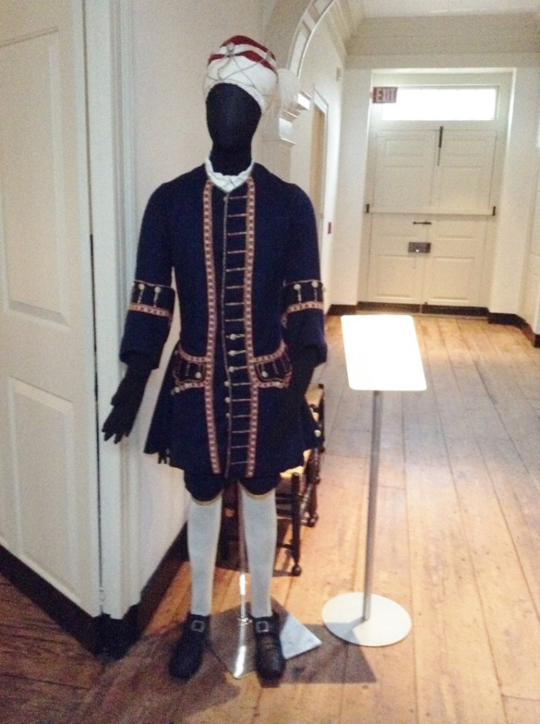
Contributions of Enslaved People to Trent’s Status and Comfort
Yaff was listed first in a group of six at 40 pounds. He was likely the butler and Trent’s personal valet.
A mannequin dressed in livery in the hallway by the main door represents Yaff as if he were greeting Trent’s guests.
Notes:
Note that the mannequins have indistinct faces – emphasizing that we don’t know how they actually looked. We have white mannequins with indistinct facial features representing Trent, his wife, and their young son for the same reason.
While Trent’s inventory offer’s little evidence of the fashion of clothing that he provided to his slaves, it does provide clues to fashion in which he kept his household. His “jap’d” (japanned) furniture, large gilt pier glasses, and other fashionable items, as well as the large number of enslaved people working in his house, suggest a stylish existence.
The manner in which Trent lived makes it quite plausible that Yaff as butler was attired in the stylish turban, jacket uniform, and even a silver collar, as was shown in early 18th century paintings.
We learned more about Yaff from a runaway advertisement that we’ll look at later.

Slide 19
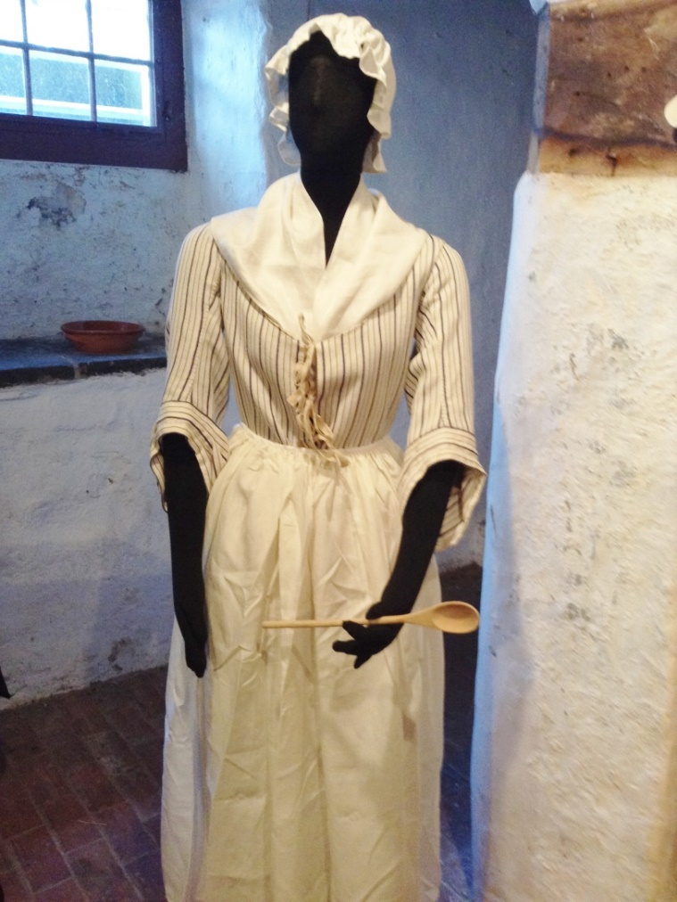
Contributions of Enslaved People to Trent’s Status and Comfort
Joan, listed second at 35 pounds, is interpreted to be the cook, as she is the only adult female.
As such, both she and Yaff had some responsibility for the overall operation of the house.
Notes:
As noted earlier, we use clues from the probate inventory to understand the likely status and skills of the enslaved members of Trent’s household.

Slide 20
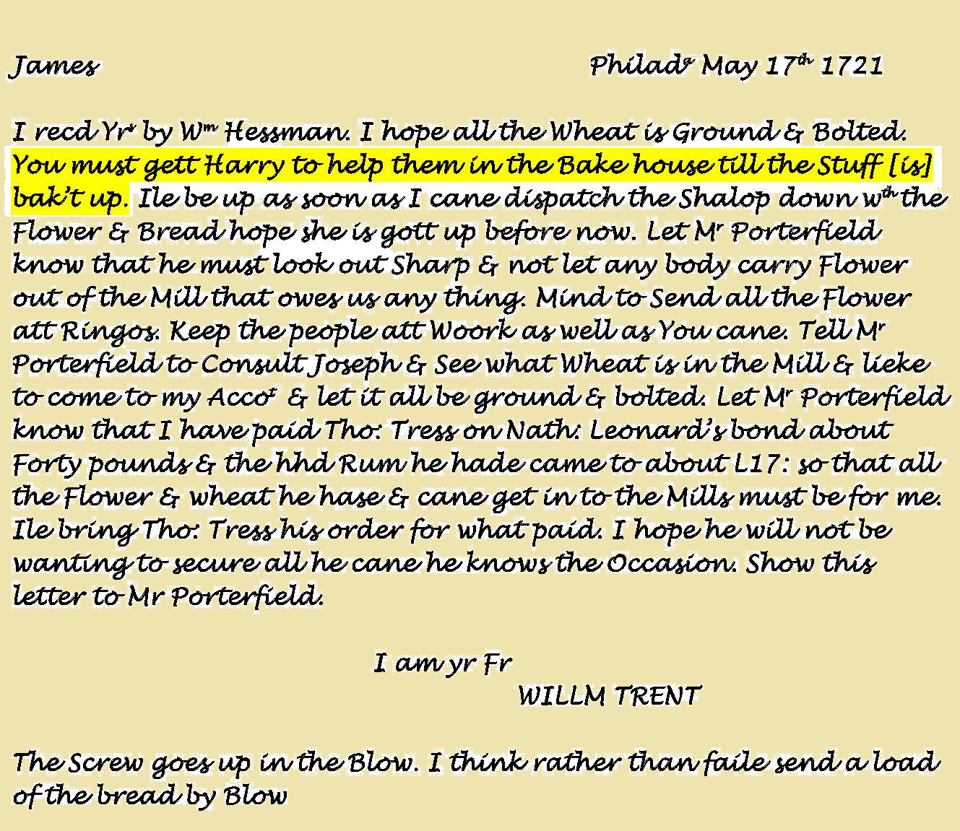
Contributions of Enslaved People to Trent’s Business Income
The five other adult men listed on Trent’s inventory likely worked on his farms and orchards, in his mills, or on his sloop transporting goods to and from Philadelphia.
The amount assigned to them in the inventory suggests a range of skills and productivity.
Notes:
Trent was a businessman and did not see his property in New Jersey as a country estate for his retirement but as a plantation – a system intended to build his wealth. His farms produced wheat for his grist mill, which ground flour for his bakehouse producing bread to ship for sale in Philadelphia.
The importance of Harry to this part of Trent’s business is mentioned in the letter – READ HIGHLIGHTED SENTENCE.
The people Trent enslaved were expected to contribute to his wealth/status and were “valued” accordingly – the amount of money that Harry was assessed (45 English pounds) was one of the highest of all of Trent’s enslaved people.

Slide 21
Observations
Observations:
  Each of the enslaved people had a “value” based on their productivity – strength and skills. Information from documents such as this probate inventory give clues about individual enslaved people.
  Trent had outstanding debts and his estate needed to be divided among his heirs. What did it mean that a large share of Trent’s estate was invested in enslaved people? What were his most “liquid” or easily sold assets?

Slide 22
The Lives of Enslaved People
Key points:
The conditions of slavery were demeaning and exploitative, regardless of their job, living arrangements, or the attitudes/behaviors of slave holders.
Enslaved people created their own ways of maintaining dignity, developing relationships, and being independent.
Enslaved people resisted their situation in different ways, some covert/subtle, others more direct, still others with force.

Slide 23


Hardships and Indignities – Privacy
Notes:
In the Trent House, there are pallets on the floor where enslaved people likely would have slept. The pallets were made of rough linen and stuffed with straw. (This same construction would have been used for the mattresses for the Trent family, though they would have been placed on bedsteads and covered with linen sheets and fine comforters.) This is based on extrapolation from evidence at other colonial sites.
Yaff’s pallet is placed in a closet between William Trent and Madame Trent’s chambers so that he would be available to them during the night. Hand bells were listed on the probate inventory and we interpret that they would have been used to summon Yaff or one of the other enslaved servants.
We ask visitors to consider the implications of having no separate living quarters on privacy and surveillance and compare this with living arrangements that the men who worked in the mills and on the plantation had.

Slide 24
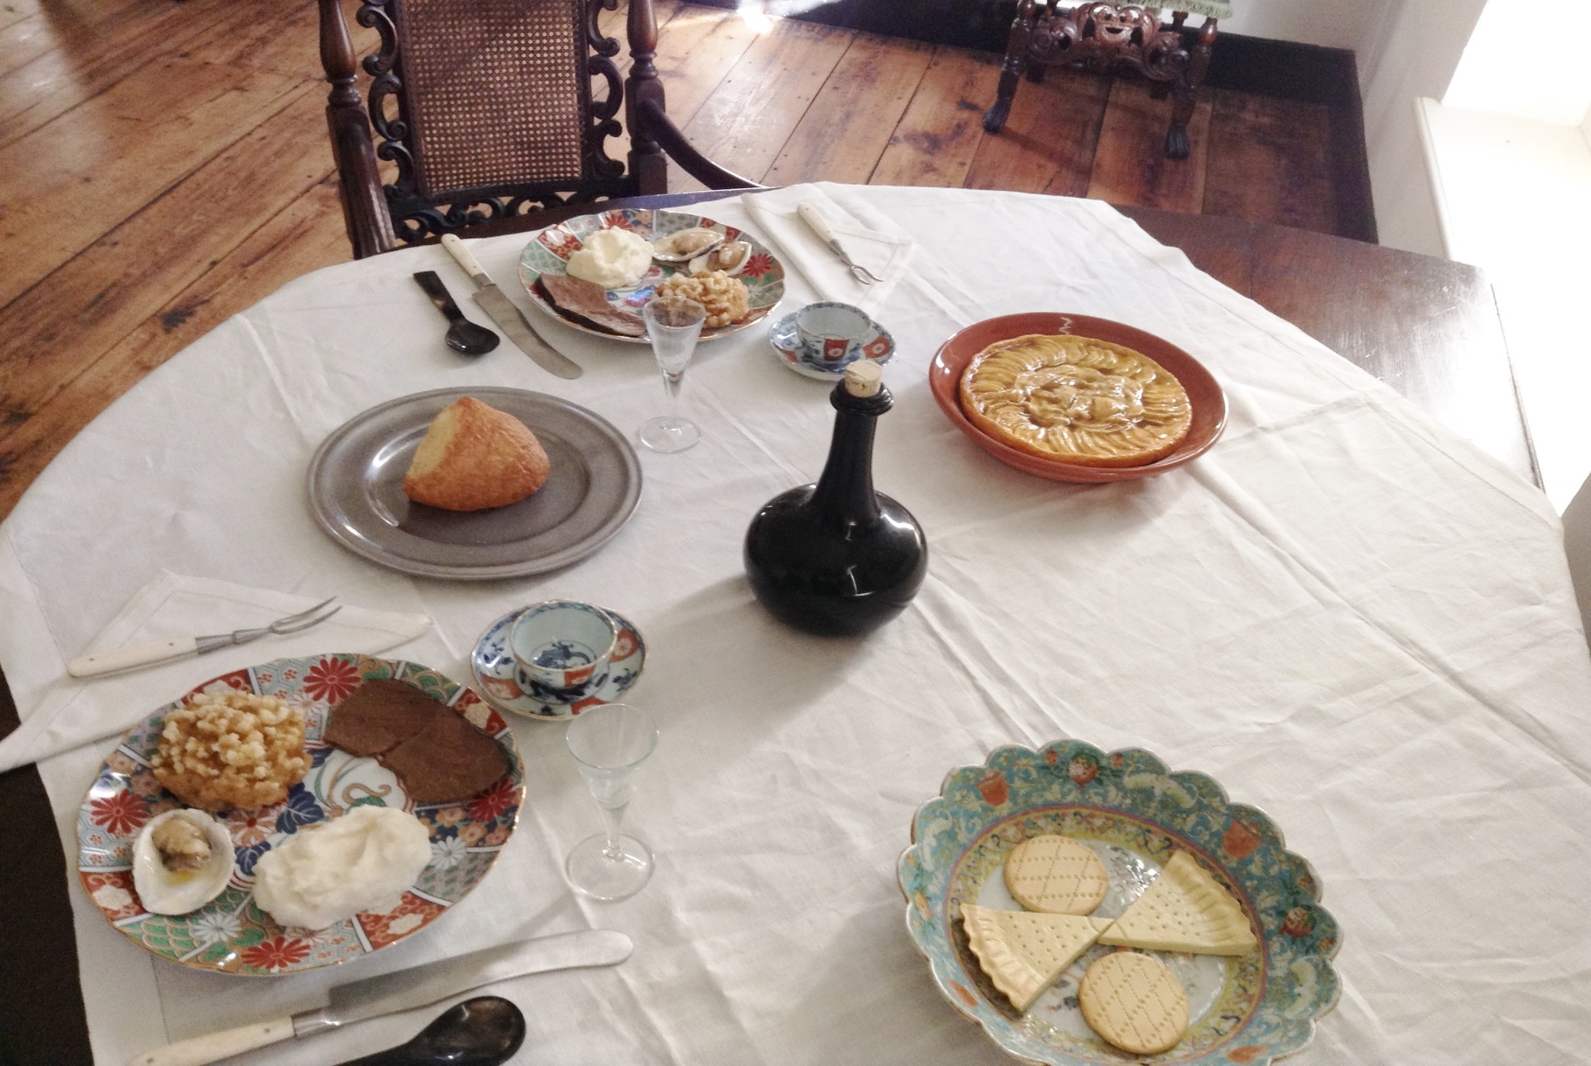
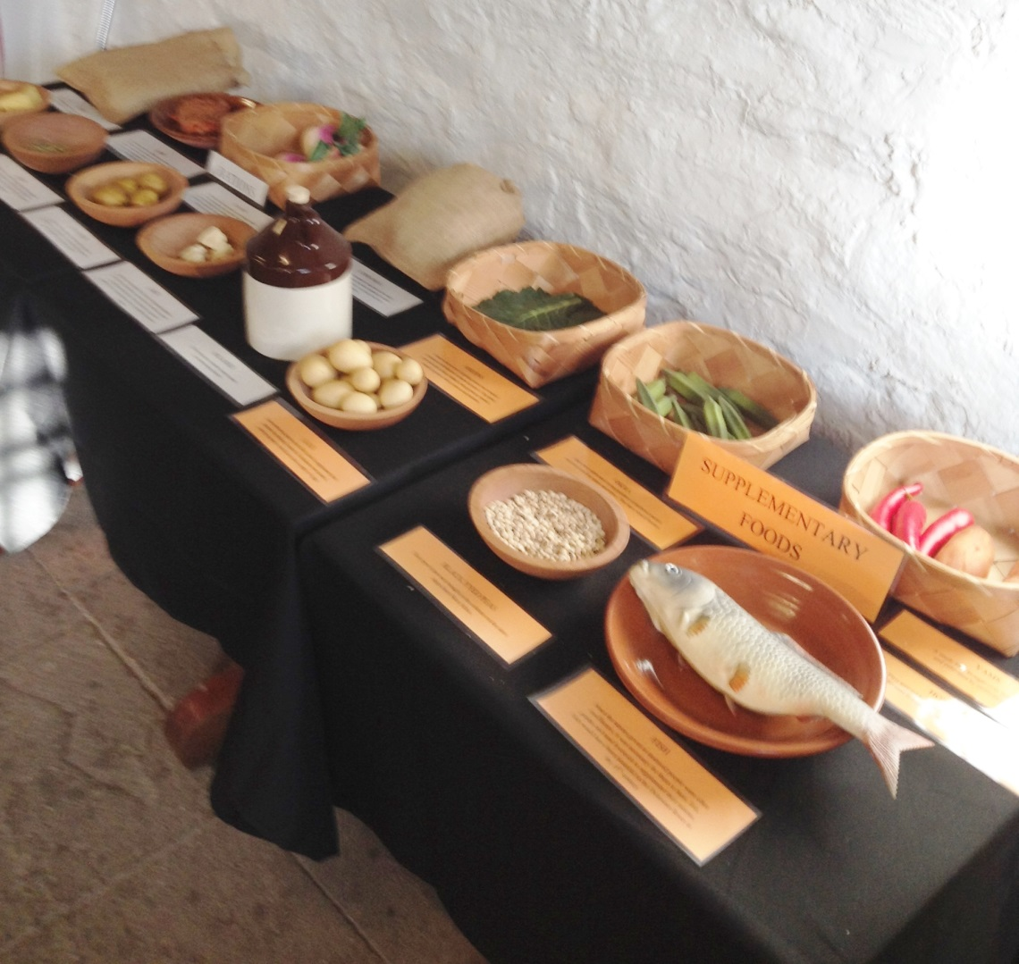
Hardships and Indignities – Food and Diet
Notes:
We have developed exhibits contrasting the diet of the elites in the 18th century with what were the likely rations provided to enslaved people, using faux foods. Again, this information is not available from primary sources directly associated with Trent, but from household accounts and other evidence from similar sites.
As you can see on the left on the dinner table for the Trents, there is beef, oysters, bread stuffing, mashed turnips, white bread and desserts on the table. There would have been wine or some type of cordial like madeira with dinner and tea. The average person in 18th c. Philadelphia would have eaten about 3000-3500 calories per day. This was a diverse diet, with an excess of calories, plenty of nutrients and high fat foods.
We juxtaposed the diet of the elites in the 18th century with the diet of enslaved people. This exhibit shows the typical food the enslaved people would have eaten – both rations and foods they produced themselves.

Slide 25
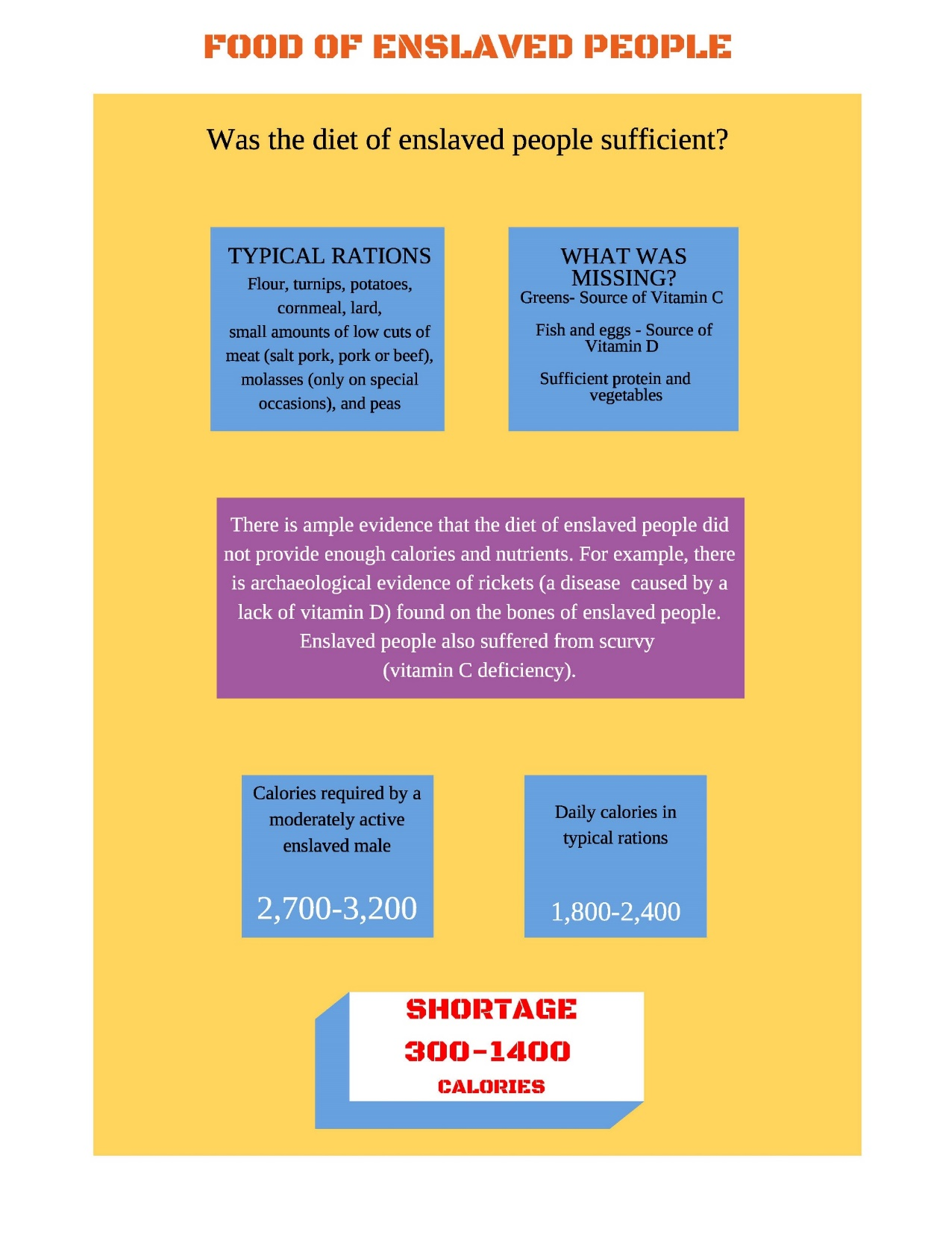
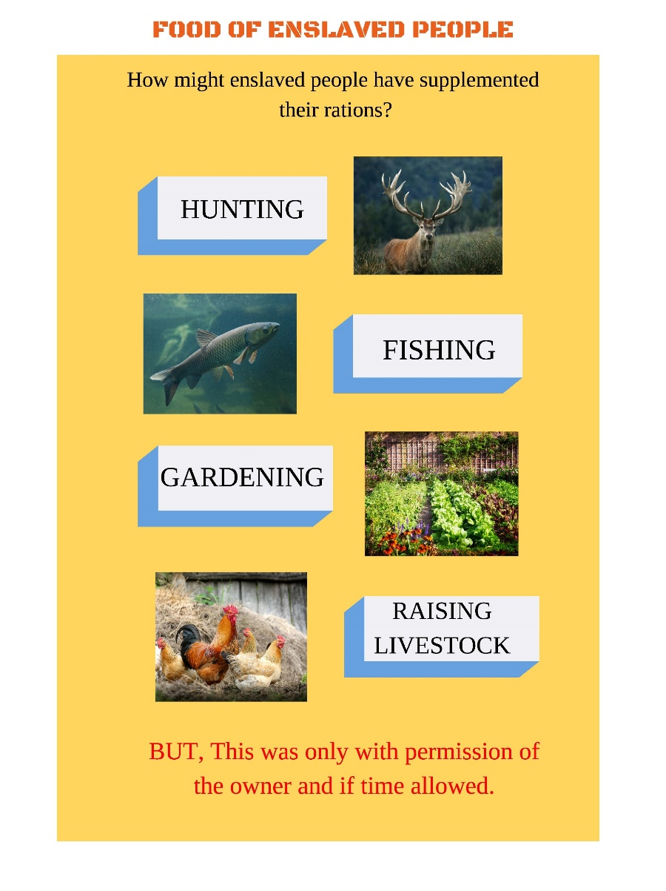
Hardships and Indignities –
Food and Diet
We used research from other sites to estimate nutritional and caloric value of typical rations for enslaved people and the impact of deficits on health.
Notes:
There was a caloric deficit in the typical ration, making it necessary for supplemental food, which might be obtained by growing a garden, hunting, fishing and raising livestock. Additionally, these food items could be sold in the local market with the proceeds going to buying other things they wanted or possibly even their freedom or a family member’s freedom.
However, ability to either produce their own food or sell it and keep the money was only possible with the consent of the owner.

Slide 26
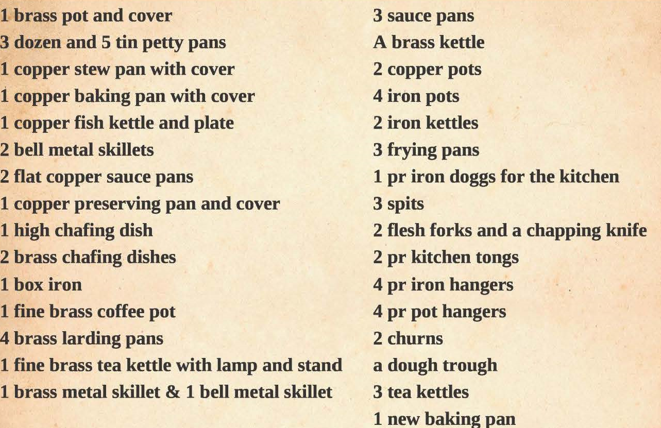
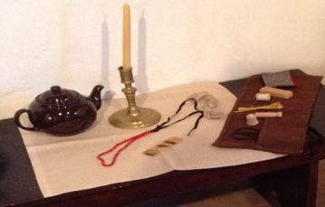
Skills and Independence - Joan
Notes:
Joan likely would have slept and spent most of her days in the kitchen, preparing the 4 meals a day for the Trents as well as food for her fellow enslaved servants.
We believe that Joan was likely a skilled cook, based on the wide variety of kitchen implements listed on the probate inventory. These include: a fish kettle, a dough trough, frying pans, baking pans, saucepans, larding pans a stew pan, a coffee pot and a tea kettle, Based on these items, it is clear that Joan could stew fish, make bread, fry, bake, make sauces and stews, lard meats and make coffee and tea, among other things.
In the kitchen, we have placed a pallet and a wooden box for Joan’s belongings, which include some extra clothing, some fabric, some sewing equipment, a necklace, a comb and a teapot and bowl. Joan may have been able to purchase some of these things, like the comb or necklace, by growing vegetables or making things and selling them in the market. This illustrates that her skills could have not only benefitted the Trents but herself as well.

Slide 27
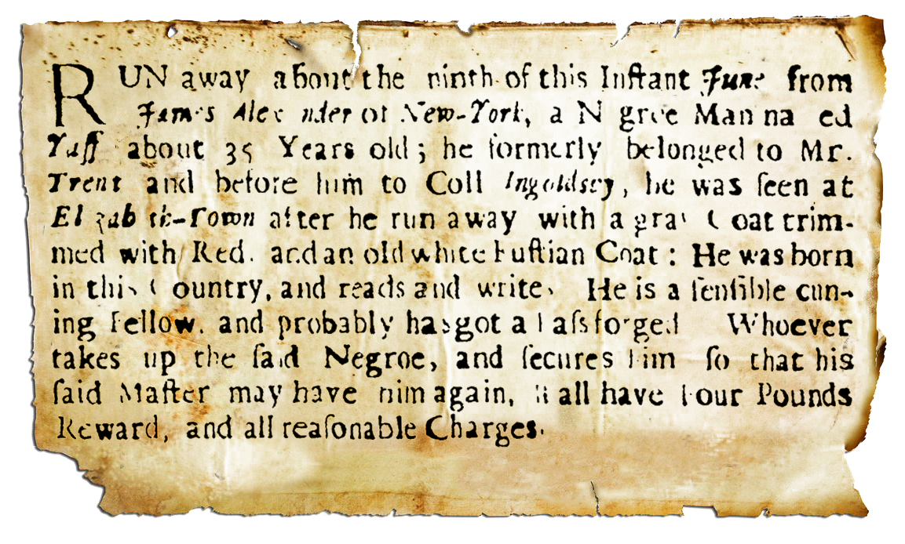
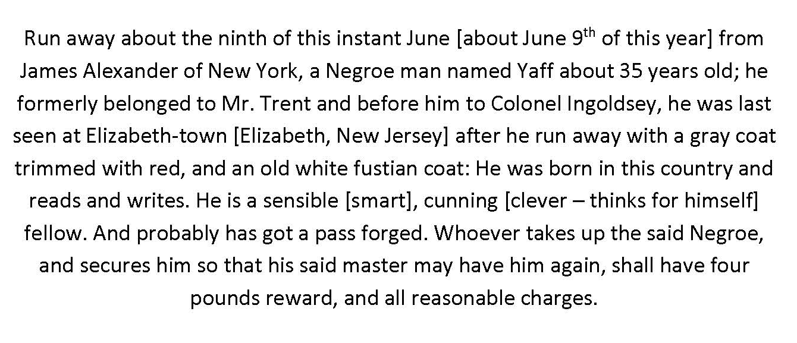
Resilience and Resistance - Yaff
Notes:
We are fortunate that a few years ago a man researching the Trent family discovered this runaway ad for Yaff published on behalf of James Alexander in the New York Gazette in 1729. From the ad it is clear that the runaway was the same Yaff who had been listed in Trent’s inventory. Yaff had apparently been sold or given to Alexander after Trent’s death – Alexander was an executor of Trent’s estate and perhaps a creditor.
Runaway ads give personal information not found in other documents like probate inventories or wills
We now know that he was about 35 years of age when he ran away from James Alexander. That suggests that he was in his 20s when he was in the Trent household. And he had previously been enslaved by another person before Trent.
He was wearing a livery uniform, which confirmed our assumptions about his position and duties.
He was seen south of New York. Was he with Alexander in Elizabethtown or on business there for him? Or did he escape from New York? Was he attempting to return to Trenton or reunite with the people from Trent’s household, or perhaps heading to Philadelphia where he might lose himself among free Blacks there?
He was born in this country – therefore, we know he was born into slavery.
He was described a “sensible, cunning” fellow, in other words intelligent and enterprising.
He could read and write – a valuable and relatively rare skill.
He likely forged a pass for himself – to aid himself in resisting being enslaved and reaching freedom.
But it is important to consider what important information about an individual is not provided and the perspective/motivation of the person placing the ad.

Slide 28
Observations
  It is challenging to balance presentation of the human suffering experienced by those who were enslaved with evidence about individual characteristics and shared resilience.
  Much of what we know comes from the perspective of slaveholders. There are first-person accounts from enslaved people that should be considered.

Slide 29
Resistance and the Law
Key points:
Enslaved people’s resistance included acts against property and people.
Colonial property law applied to enslaved people; criminal law addressed their resistance.
Acts of resistance by enslaved people were met by increasingly restrictive and harsh laws and corporal punishment.
At the same time, the colonial economy and individual households depended on the labor of enslaved people.
This dynamic created and supported individual and cultural beliefs and behaviors in justification of slavery.

Slide 30
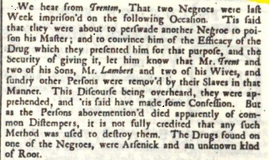
The Case of Trent’s Death
In March of 1737, this article was published in the Pennsylvania Gazette.
Two men of African descent, possibly enslaved though that is not stated, were overheard trying to convince another to poison his master. They apparently boasted that they could provide a poison that killed Mr. Trent and others. The two men were quickly apprehended, found with arsenic and an unknown root, and apparently confessed.

Slide 31
How Did Trent Die?
On Friday, the 25th of this instant, William Trent Esq. Chief Justice of the Province of New Jersey departed this life (being seized with a fit of apoplexy) at his house in Trenton. He was one that was universally beloved, and is as much lamented.
The Boston Gazette – January 11-18, 1725
William Trent died suddenly on
Christmas Day 1724
in what was described as a “fit of apoplexy.”

Slide 32
Was William Trent Poisoned?
At that time, apoplexy referred to any sudden death,
particularly if the victim died very quickly with a sudden loss of consciousness.
A stroke or a heart attack might have been the cause of Trent’s apoplexy.
In fact, the author of the Pennsylvania Gazette article seems to doubt
that Trent was poisoned, stating that Trent and the others
mentioned by the accused men
“died apparently of common distempers” or diseases.
However, this article does raise the possibility that Trent was poisoned
by his enslaved servants with a substance provided by the two accused men.

Slide 33
What Really Happened?
What evidence was used to convict the two men?
Does this evidence support their claim of providing poison that killed William Trent?
If this claim was not proven, why were the men executed?
What does this suggest about the fear and reality of resistance by enslaved people?

Slide 34


What Was the Evidence?
The men were found with arsenic,
a powerful poison,
and an unknown root.
There appears to have been a witness to the men’s offer to provide poison.
And the men were reported to have confessed to attempting to provide poison with the intent to help others kill their enslavers.
Whether other evidence was presented related to their claims regarding Trent and others is not known.

Slide 35

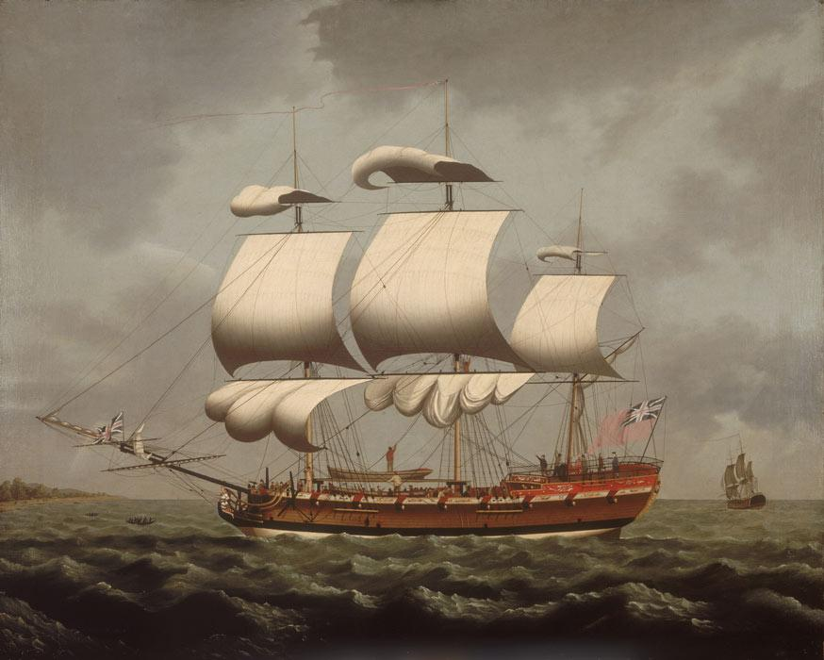
The unknown root that was found on one of the accused may have been used in African folk medicine or sorcery. For example, seeds of the wild licorice plant were worn as necklaces and talismans.
This root may have been brought to the colonies on a ship transporting enslaved people, possibly as food or medicine. Captains of these ships used native roots to cure fevers. We know that vegetables like yams and okra were brought from Africa to the colonies.
Artist: William Jackson

Slide 36
Does the Evidence Support Their Claim that Trent Was Poisoned?
If given in sufficient quantity, arsenic can cause convulsions, coma, and death within a few hours. This could be described as a fit of apoplexy.
There was apparently no suggestion of poisoning at the time of Trent’s death and it was accepted as death from natural causes.
Asserting that their poisons were the cause
of the sudden death of a well-known man
13 years earlier would have been
hard to disprove and easy to claim.

Slide 37
Why Were the Men Executed?
It appears that these two men were found guilty and executed in 1738.
The Pennsylvania Gazette
June 15, 1738
“We hear from Burlington, that two Negroes found guilty of practising Poison, by which they had destroy'd sundry Persons,
were executed there last Week.”
Although we do not know what evidence was presented as proof that the men committed the crime of murder, they were executed for “practising Poison.”
In fact, conspiracy to commit murder by poisoning and attempting to incite others to commit murder in the same fashion were capital offenses, regardless of whether death occurred.

Slide 38
What Law Justified the Execution?
While this particular law was enacted in 1768, it amended an 1713/14 act, making the court proceedings easier and quicker, with multiple courts eligible to hear and decide on these cases. As the preamble states, the 1768 law was to improve “the present Mode of trying Negro and Mulatto Slaves, for Murder and other capital Crimes, by Three or more Justices, and Five of the principal Freeholders of the County, [which] hath on Experience, been found inconvenient.”
…every Negro, Indian, or Mulatto Slave, who shall murder or conspire, or attempt the Death of any of his Majesty's Liege People in this Colony…and be thereof convicted, by Confession or Verdict, in the Supreme Court, Court of Oyer and Terminer and General Goal Delivery, or Court of General Quarter Sessions of the Peace, of the County wherein the Fact shall be committed, shall suffer Death without Benefit of Clergy…

Slide 39

Why Were Such Punishments Considered Necessary?
Laws governing enslaved people in colonial
New Jersey were exceedingly strict, and punishments were draconian.
The law that required execution of enslaved individuals convicted of murder or conspiracy to murder also mandated capital punishment for rape, arson, and serious injury.
These laws were intended to prevent
and punish efforts by enslaved people
to resist their bondage.
Fear of these punishments was intended as a deterrent to resistance by enslaved people.

Slide 40
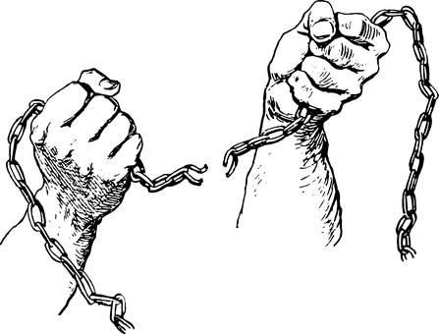
Many enslaved people did resist enslavement using force in New Jersey and the other northern colonies.
A particularly violent uprising in New York in 1712 prompted lawmakers to write new codes governing enslaved people that were even stricter and punishments harsher.
The New York Assembly, following the revolt, passed "An Act for the suppressing and punishing the conspiracy and insurrection of Negroes and other Slaves,“ which mandated that any enslaved person found guilty of murder, rape, arson, or assault was to "suffer the pains of death in such manner and with such circumstances as the aggravation or enormity of their Crimes...shall merit and require.“

Slide 41
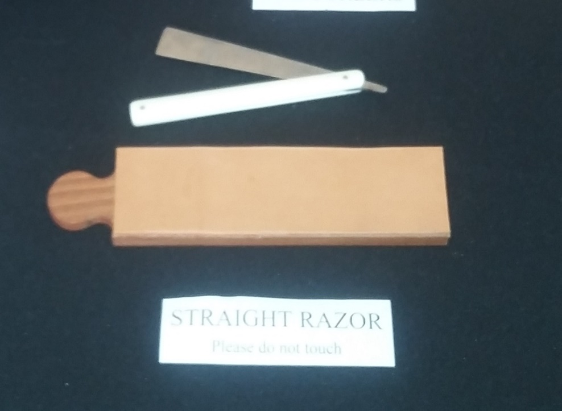
How Did Fear of Resistance Co-Exist with Trust?
Yaff, the only other adult man living with the Trents, was both butler and Trent’s manservant or valet. As butler, he would have had major responsibility for managing Trent’s household. And as valet, he would have shaved Trent daily with a straight razor.
Yaff would have had the opportunity to murder Trent with the straight razor but he did not. Was Trent confident in Yaff’s loyalty? Or was Trent counting on Yaff’s fear of the punishment he would have received?
What else might have Yaff considered in his decision not to resist through murder?
The consequences for other enslaved people in Trent’s household? His personal values about human life?
Notes:
Fear of resistance coupled with loss of valuable property was behind laws such those that restricted the movement of enslaved people (required written passes), limited congregating, and forbid their use of firearms or consumption of alcohol.
At the same time, many households such as that of Trent had enslaved people living in close quarters with those who owned them as property. How was the fear of resistance by enslaved people as a group, held by the slaveholding class, reconciled with close co-existence and apparent trust?
Trent’s enslaved man Yaff was both butler and Trent’s manservant or valet. As butler, he would have had major responsibility for managing Trent’s household. And as valet, he would have shaved Trent daily with a straight razor. Given that he was the only other adult man in the household, Yaff would have had the opportunity to murder Trent with the straight razor but he did not.

Slide 42
Observations
  The history of enslavement is linked with racial disparities and racial divisions today.
  Possibilities to explore:
    Beliefs about people of African descent
    Fear of resistance and retribution
    Desire to preserve economic & political status
    Limitations on opportunities such as education and property ownership

