Slide 1
UNCOVERING THE LIVES OF NATIVE AMERICANS THROUGH ARCHAEOLOGY
What We Are Learning at
the William Trent House Museum
Shawn Carney – April 2020

Slide 2
Who were the Native Americans that lived on the Trent house property before Trent?
The Native American people who lived on the Trent House property are called the Lenni Lenape or Lenape.

Slide 3
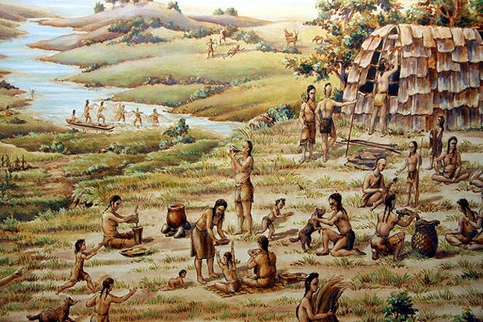
The Lenape
They settled in the New Jersey area thousands of years ago.
They fished and hunted and collected seeds, roots and nuts. After some time, they began to farm the land.
As more and more European colonists came, the Lenni Lenape were pushed from their lands and eventually most were relocated to Oklahoma where many descendants still live today.

Slide 4
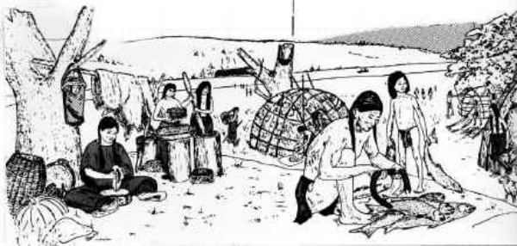
How can we learn about the Lenape people through archaeology?
We can study the things they left behind thousands of years ago.

Slide 5
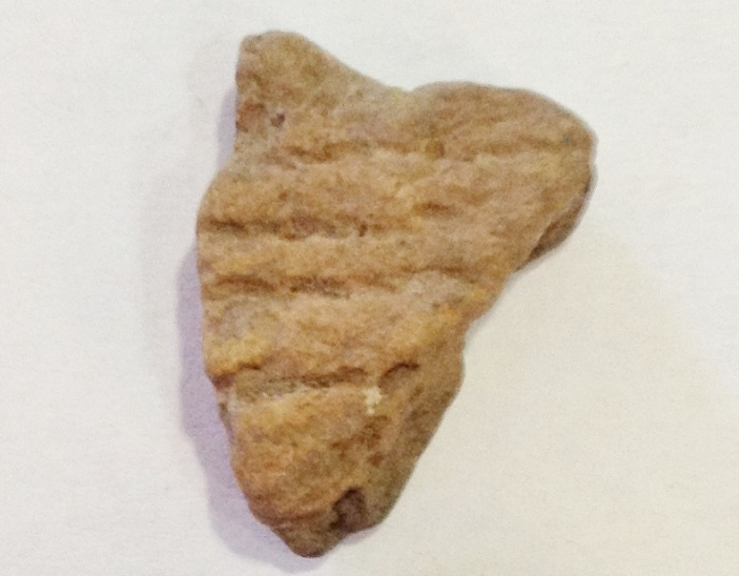
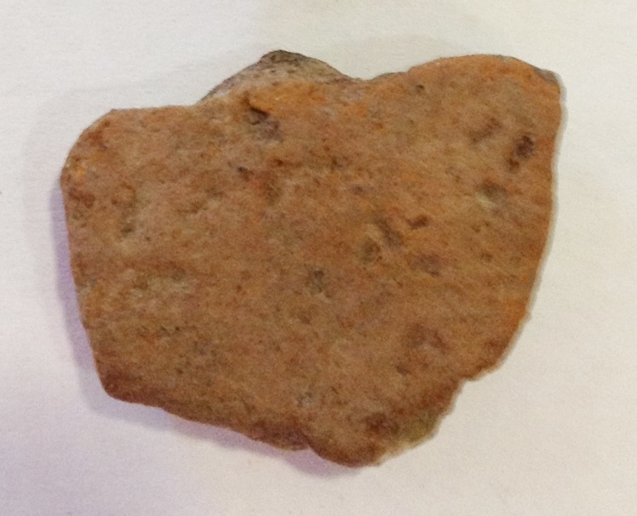
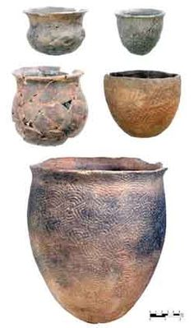
What did the Lenape leave behind?
They left behind pottery, also called ceramics, made for cooking and storing food
They are most often found in pieces
These pieces are called potshards
These potshards were found at the Trent House!

Slide 6
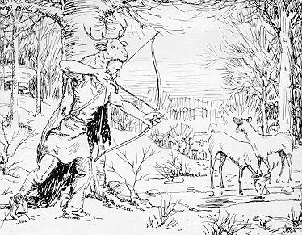
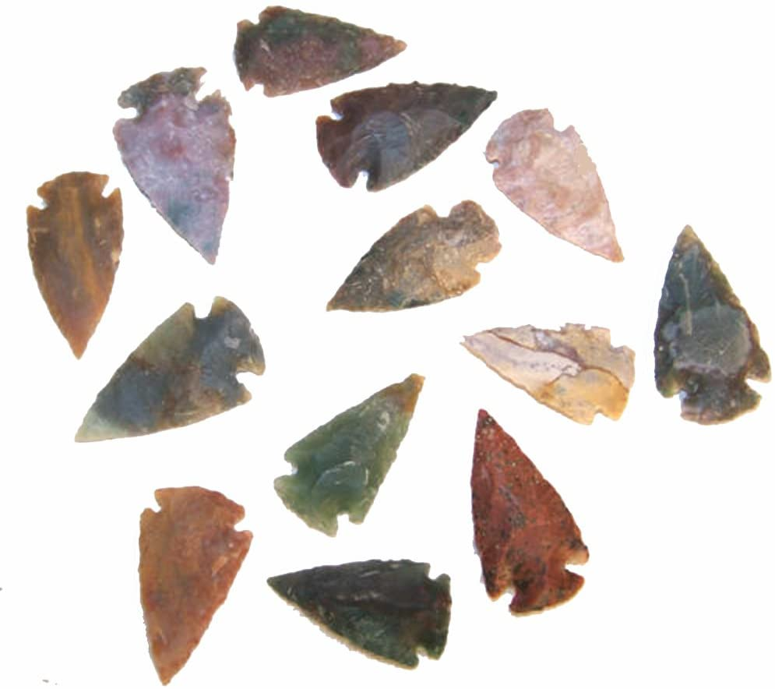
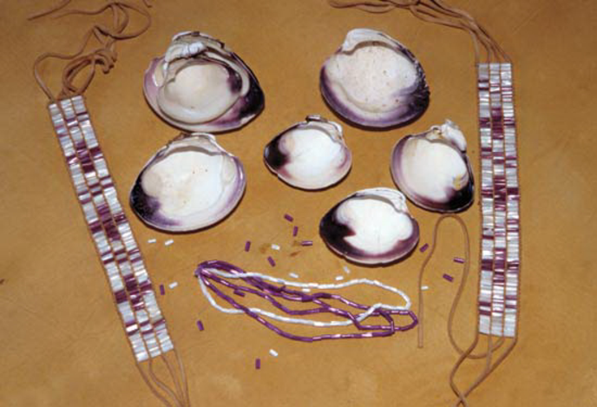
What did the Lenape leave behind?
They also left behind arrowheads – chipped stone tools used for hunting animals -
and wampum, which was made from clam shells and used as jewelry and money

Slide 7
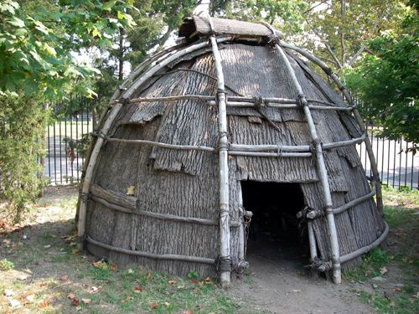
Some of what the Lenape left behind would not last under the ground
For example, the houses the Lenni Lenape built would not last. They are made of wood, which is organic.
Organic means that something comes from living things.
Organic things rot or decay under the ground.

Slide 8
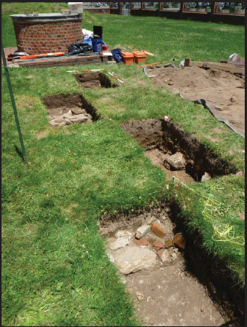
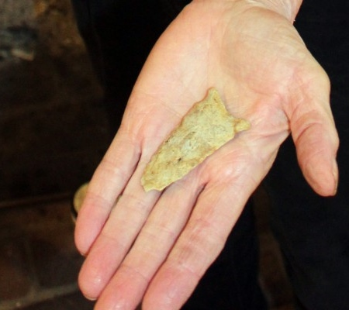
What is Archaeology?
Square holes are dug in the ground to find these belongings. Digging these holes is called excavation.
These belongings, like the pottery and arrowheads made by the Lenape, are called artifacts
Archaeology is the study of how humans used to live by uncovering the remains of their belongings from the earth.

Slide 9
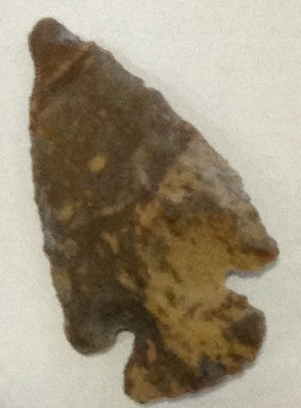
What are Artifacts?
Artifacts can be from recent times, like this coin
Or they can be thousands of years old, like this arrowhead
Artifacts are objects made or changed by humans.
For example, the pottery pieces and nails that you see here are artifacts.

Slide 10
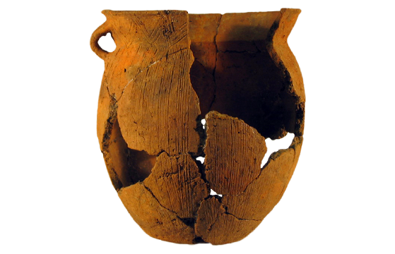
Most artifacts are in pieces when found. Archaeologists try to put the pieces back together.
It is called mending and it is like putting a puzzle back together.

Slide 11
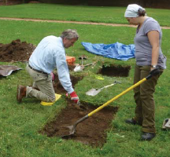
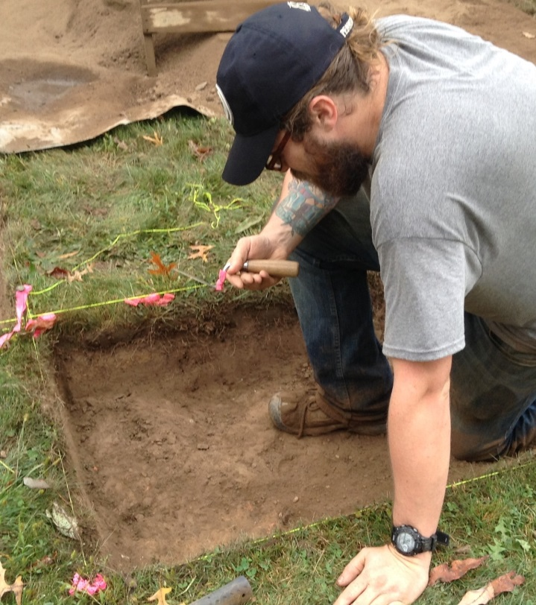
What is an archaeologist?
Archaeologists excavating at the Trent House
The work is done very carefully
An archaeologist studies how humans lived in the past through the artifacts they find.

Slide 12
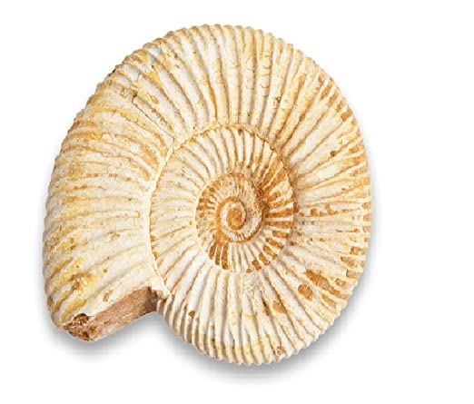
Archaeologists are different from Paleontologists
Archaeologists look for artifacts – remains of human belongings
Paleontologists look for fossils – remains of dinosaurs and extinct animals

Slide 13
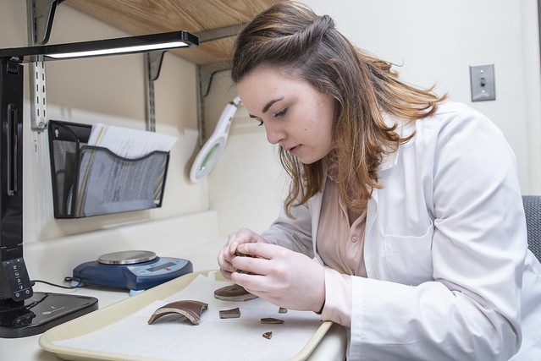
Archaeologists are also different from Historians
Archaeologists study the past through the artifacts they find
Historians study the past through written documents
Since the Trent house is both an archaeological site and a historic site, both archaeologists and historians have studied it.

Slide 14
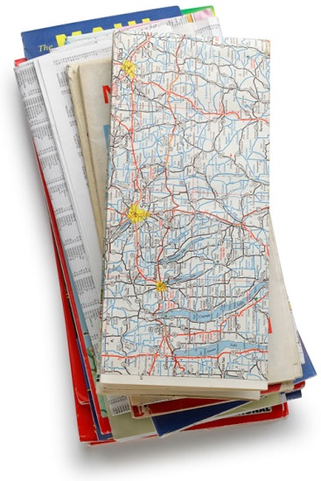
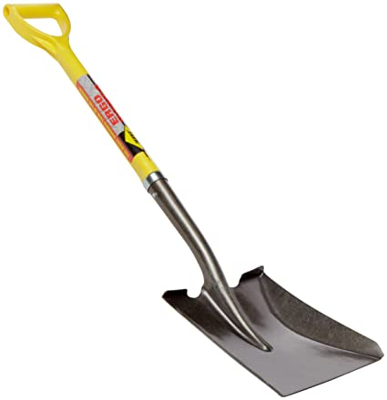
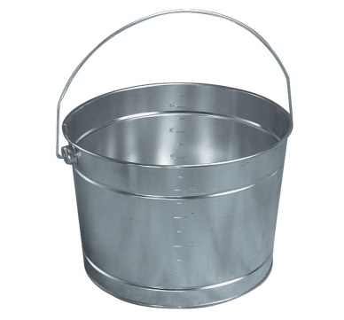
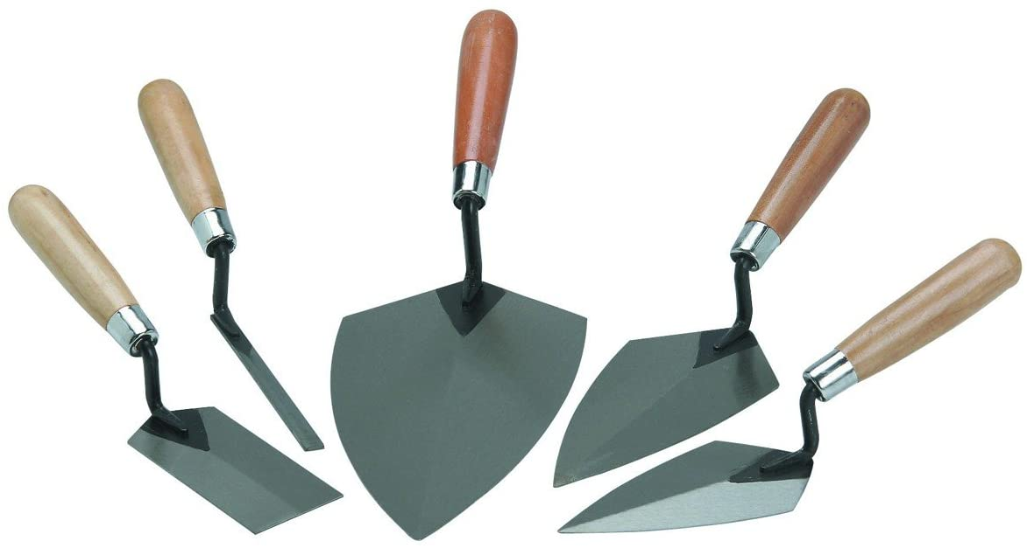
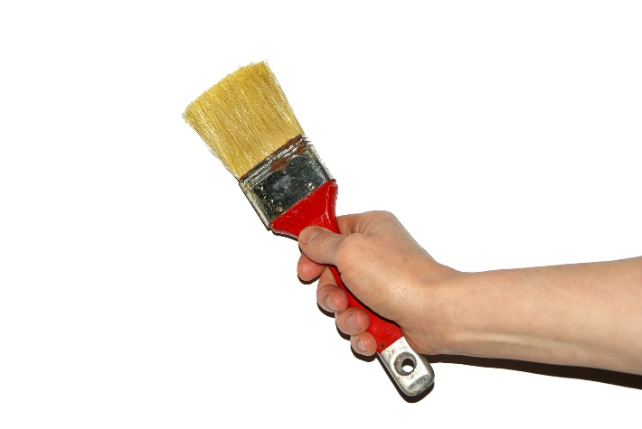
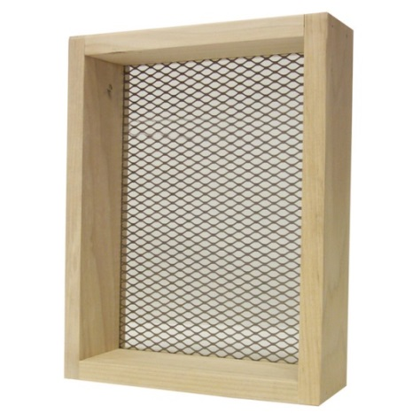
What do archaeologists use to find artifacts ?
Measuring tape for measuring how deep you are digging
Maps for finding sites
Shovel and bucket for digging
Paint Brush for brushing soil from artifacts
Trowels for scraping the soil
Screen for sifting soil

Slide 15
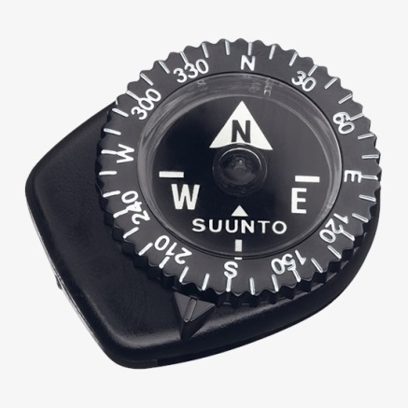
What kind of tools do archaeologists use?
Compass for finding sites
Plastic bags for bagging artifacts
Notebook and pencil for taking notes
Camera for taking pictures of the site and excavation
Computer for cataloging artifacts

Slide 16
Archaeologists look for sites. What are sites?
Sites can be prehistoric – before written history
Or they can be historic – with a written history
The Trent House site is both a prehistoric
and a historic site. People have lived there for thousands of years.
Sites are places where humans once lived that contain artifacts.
The Trent House is an archaeological site.
Many artifacts have been found at the Trent House.

Slide 17
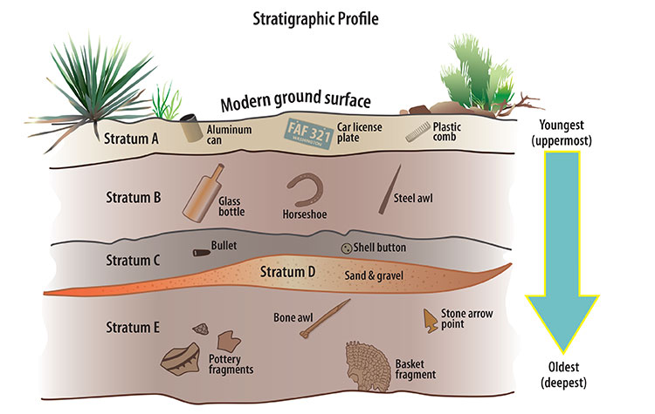
How can archaeologists tell how old an artifact is?
Generally speaking, the deeper you find something in the ground, the older it is. Notice how the modern artifacts are at the top and the Native American artifacts are at the bottom.

Slide 18
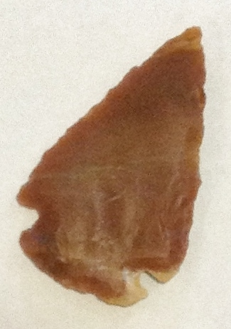
What do artifacts tell us about Native American people?
Arrowheads tell us that the Lenape hunted animals.
Some of these animals were large like deer and some were small like rabbits. Some of the stone used for arrowheads came from other parts of the country, meaning that the Lenape either traveled to get them or that other native groups traveled to meet with the Lenape.
Pot shards tell us that the Lenape made pots to cook in and store food and water.
Often times the pottery was decorated. Sharpened stones, sticks, and cord were used to make designs on the clay.
Native American pottery is most often found in pieces because it is very fragile.

Slide 19
What do artifacts tell us about Native American people?
Wampum tells us quite a lot about the Lenape.
It tells us that the Lenape, and other Native Americans of the Northeastern United States made and wore jewelry, like necklaces, bracelets and earrings. It also tells us that the Lenape had a system of currency or money.

Slide 20
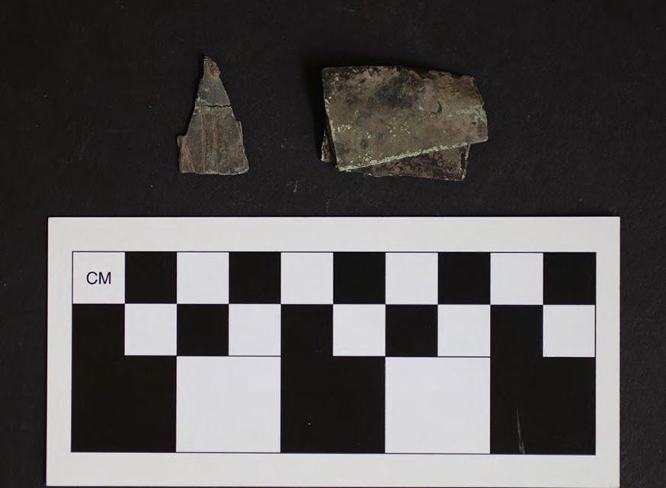
What do artifacts tell us about Native American people?
These artifacts are evidence that Native Americans traded with Europeans at the Trent House, for things like copper kettles. They would take the kettles and cut them up, making them into different things. The artifact on the left is thought to be a pendant for a necklace.

Slide 21
What have you learned about archaeology and Native American people?
Take this fun quiz to find out!

Slide 22
Archaeology Quiz
Who were the Native Americans that lived on the Trent House Property?

Slide 23
Archaeology Quiz
Most descendants of the Lenni Lenape live in which state?

Slide 24
Archaeology Quiz
What kinds of things did the Lenape leave behind?
Artifacts
Ceramics
Arrowheads
All of the above

Slide 25
Archaeology Quiz
What is wampum made from?
Wood
Very small rocks
Purple and white clam shells
Turtle shells

Slide 26
Archaeology Quiz
What is the object in the picture below?
A Native American Artifact
A potshard
A piece of ceramic
All of the above

Slide 27
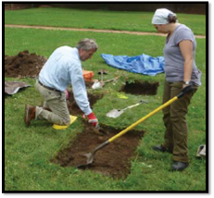
Archaeology Quiz
Very carefully digging square holes to find the remains of human belongings is called___________________________.

Slide 28
Archaeology Quiz
TRUE OR FALSE
Archaeologists and Paleontologists are the same thing.

Slide 29
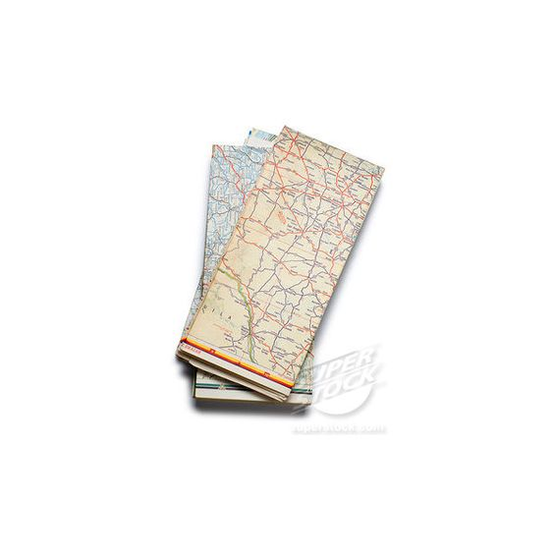
Archaeology Quiz
Which of these things do historians use to study the past?
Letters
Maps
Books
All of these things

Slide 30
Archaeology Quiz
An object made or changed by a human is called _____________________.

Slide 31
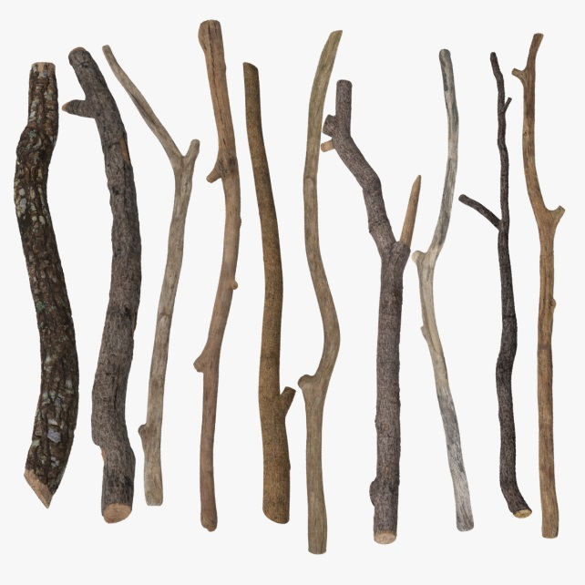
Archaeology Quiz
Which of these is organic and will decay under the ground?
Arrowhead
Wood
Bottle
Coin

Slide 32
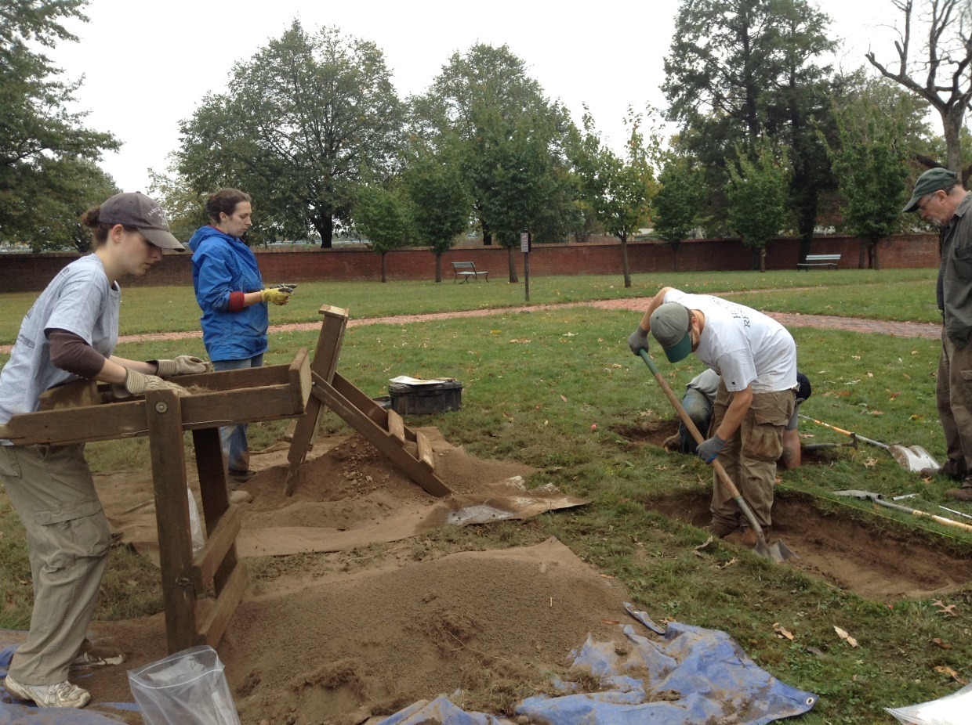
Archaeology Quiz
TRUE OR FALSE
Archaeologists study the past through the artifacts they find.

Slide 33
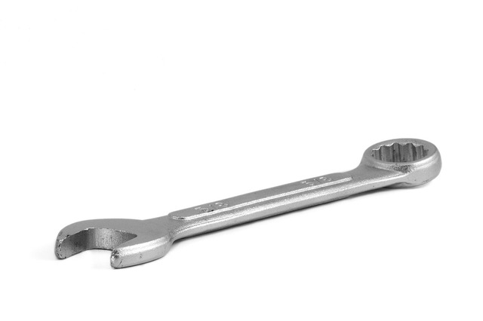
Archaeology Quiz
Which of these is NOT an archaeologist’s tool?
Wrench
Shovel
Screen
Measuring Tape

Slide 34
Archaeology Quiz
What do archaeologists use these for?
Painting the artifacts
Painting a picture of the excavation
Carefully brushing soil away from artifacts
Dusting off antiques

Slide 35
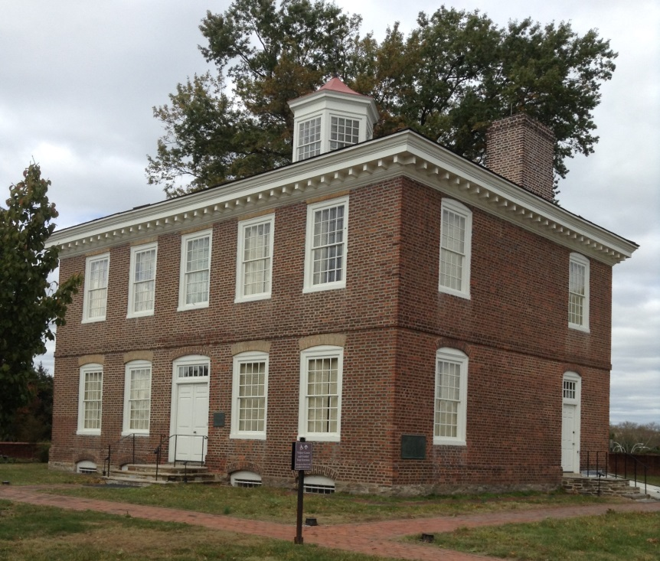
Archaeology Quiz
What type of archaeological site is the Trent House?
Old
Historic
Prehistoric
Both Prehistoric and Historic

Slide 36
Archaeology Quiz
TRUE OR FALSE
The deeper the artifact is in the ground, the older it is.

Slide 37
Archaeology Quiz Answer Key
1. The Lenni Lenape or Lenape
9. An artifact
10. Sticks (wood)
2. Oklahoma
11. True
3. All of the above
4. Purple and white clam shells
12. Wrench
13. Carefully brushing soil away from artifacts
5. All of the above
14. Both Historic and Prehistoric
6. Excavation
7. False
15. True
8. All of these

Slide 38
Resources
https://www.saa.org/education-outreach/teaching-archaeology/k-12-activities-resources
https://thehomeschoolresourceroom.com/2017/07/28/introduction-to-archaeology-and-the-ancient-world-streaming-media/
https://www.scholastic.com/teachers/collections/teaching-content/native-american-heritage-0/

Slide 39
Image Sources
http://jpronan1776.blogspot.com/2016/02/lenni-lenape-tribe.html
http://www.lenapelifeways.org/lenape1.htm
https://www.pinterest.ca/pin/2610687281828056
https://www.pinterest.com/pin/730779477011621897/
https://barnegatshellfish.org/wampum_historyiselemantal.png
https://capecodchronicle.com/en/5448/harwich/5236/Historic-Arrowhead-Found-On-Habitat-Construction-Site-Local-History.htm
http://www.archeolore.com/works/ceramic
http://fearsltd.blogspot.com/2017/12/the-re-broken-cup-redux.html
https://bottle.sumberharga.co/old-clorox-bottles-brown-glass-value/2/
https://us.schleich-s.com/en/US/dinosaurs/products/tyrannosaurus-rex-14525.html
https://www.shutterstock.com/search/fossile+ammonite

Slide 40
Image Sources:
https://www.hofstra.edu/public-archaeology/archaeology-lab.html
https://i.moneyversed.com/mystery-rock-france
https://www.gettyimages.com/photos/foldedmap?mediatype=photography&phrase=folded%20map&sort=mostpopular
https://www.houzz.com/products/ames-16-gauge-steel-square-shovel-with-fiberglass-handle-prvw-vr~54113874
https://www.maxwarehouse.com/products/leaktite-paint-pail-metal-5-qt-pack-of-12?gclid=EAIaIQobChMI0-HvudSd6gIVhK7ICh00FwkhEAQYAiABEgJ3BfD_BwE
https://zzzippy.com/home-and-garden/kuert-outdoor-living/concrete-and concrete-tools
https://www.wantitall.co.za/brands/pete-rickard/homegarden/p1
https://www.suunto.com/en-us/Products/Compasses/Suunto-Clipper/Suunto-Clipper-LB-NH-Compass/
https://www.switchbacktravel.com/best-dslr-cameras
https://www.crowcanyon.org/index.php/stratigraphicdating
https://www.thriftyfun.com/Alternative-Uses-for-Elmers-Glue-1.html
Hunter Research Inc.
Pixabay.com

Slide 41
Image Sources:
https://www.kshb.com/news/local-news/adopt-a-letter-to-santa-through-usps
https://www.business-standard.com/article/technology/has-the-print-book-trumped-digital-beware-of-glib-conclusions-117051000336_1.html
https://brainly.in/question/3797881
https://www.fs.usda.gov/Internet/FSE_DOCUMENTS/stelprdb5360668.pdf

